Slide 1
Algorithmic Game Theory Semester Project
Topic - Hawk and Dove
Team Members – Aditya Piyush, Aryan Singh & Jayesh Chandan
Course Code – CS60025

Slide 2
Hawk-Dove Model
The hawk-dove model is an evolutionary game theoretical model developed by John M. Smith (1982).
The model describes the contest between two fundamentally different behavioral strategies, hawks (selfishness) and doves (prosociality), when competing over a shared resource.
If natural selection is based on competition, then prosocial traits should not evolve. The hawk-dove model provides a simplistic framework to investigate the conditions that favors the evolution of prosocial behavior.
Overall a hawk outcompetes doves within groups, but a group of doves outcompete a group of hawks.
Thus, for either species to evolve an Equilibrium shall exist, and we shall explore it.

Slide 3
Hawk and Dove – Normal Game Form
Game = < {1, 2}, {Dove, Hawk}, u>
Players : Player 1 and Player 2
Strategy :
Hawk – An aggressive Strategy, they fight for food.
Dove - A Defensive Strategy, they share the food.
Utility Matrix : B – Available Food, C – Cost of fighting
Player 1 \ Player 2 | Hawk | Dove
Hawk | B/2 - C, B/2 - C | B, 0
Dove | 0, B | B/2 , B/2

Slide 4
Equilibriums in Hawk & Dove
If B/2 - C > 0
Then Hawk, Hawk is a strictly dominant strategy equilibrium.
Else when B/2 - C <= 0
If Player 1 chooses to Hawk and Player 2 chooses to play Dove
Then no player has an incentive to change their strategy, B > B/2 and 0>= B/2 - C.
If Player 1 chooses to play Dove and Player 2 chooses to play Hawk (PSNE)
Then no player has an incentive to change their strategy, 0>= B/2 - C and B > B/2 (PSNE)
Else when player 1 chooses Hawk and player 2 chooses Hawk, then both players have an incentive to unilaterally change their strategy to Dove, since 0 >= B/2 - C.
Else when player 1 chooses Dove and player 2 chooses Dove, then both players have an incentive to unilaterally change their strategy to Hawk, since B >= B/2 .
Player 1 \ Player 2​ | Hawk​ | Dove​
Hawk​ | B/2 - C, B/2 - C​ | B, 0​
Dove​ | 0, B​ | B/2 , B/2​

Slide 5
MSNE in Hawk and Dove
When B/2 - C <= 0,
The game has a Mixed Strategy Nash Equilibrium
{ {B/2C, 1 – B/2C}, {B/2C, 1 – B/2C} }
In other words, player plays hawk with B/2C probability and plays dove with 1 – B/2C probability.
This MSNE can be interpreted as the ratio of population having the traits Hawk and dove under equilibrium condition. And we shall verify this using a simulation.

Slide 6
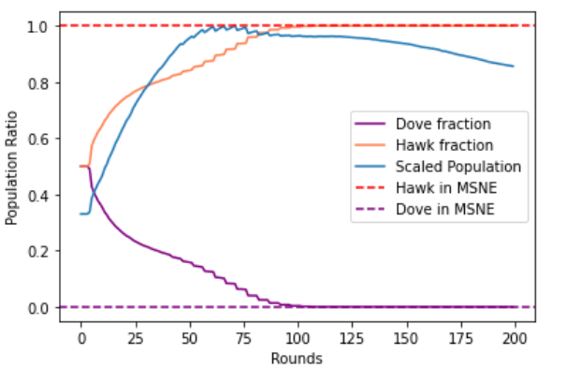
Simulation vs Theory
B = 40 and C = 10 , Case of SDSE

Slide 7
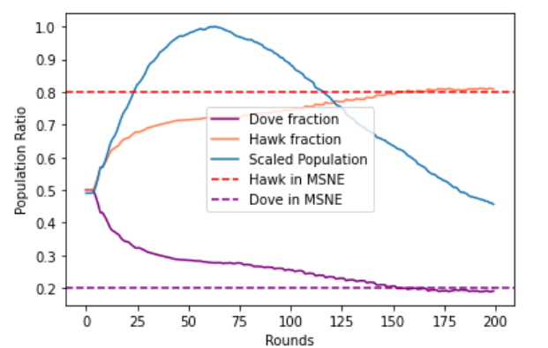
B = 40 and C = 25, MSNE ( 80 : 20 ) total Population 1861
B = 40 and C = 20

Slide 8
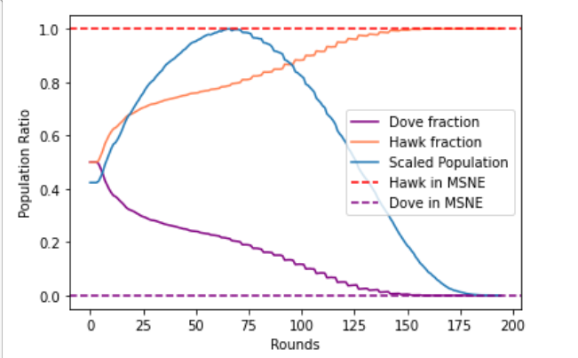
B = 40, C = 20 (still SDSE, but the population dies soon after attaining equilibrium)

Slide 9
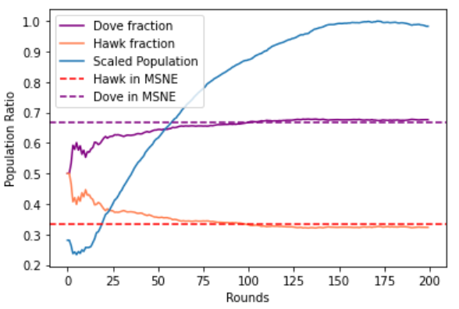
B = 40, C = 60 MSNE ( 67: 33) Population size: 6993

Slide 10
Conclusion
Our simulation verifies the MSNE as evolutionary stable strategy.
When B-2C > 0, then the hawks dominated the population.
And as we increased the value of C (i.e. cost of fighting) the dove population started to increase.
And since doves share and don't waste energy on fighting (defensive strategy) the population size started to increase and it went from 1861 to 6993 when we change C from 25 to 60.
For an ideal community to increase its population they must punish the Hawk community by increasing cost of fighting.

